Slide 1

Analyzing the NYC Bike Share System
April 2021
Anita Ghafourian

Slide 2
Table Of Contents
Overview
Exploratory Data Analysis
Feature Creation And Data Segmentation

Slide 3
Overview
NYC launched Citi Bike on May 27, 2013
  Over 400 stations and 9000 bikes in 2015
  22% growth in trips taken using Citi Bike in 2015
  Average of 25 thousands riders daily
  Analyzing Citi Bike program 2014 and 2015 data for opportunities to reduce expense

Slide 4
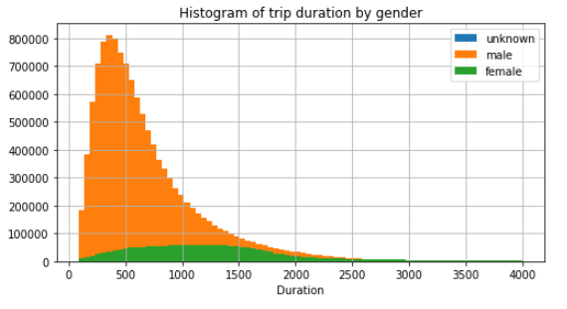
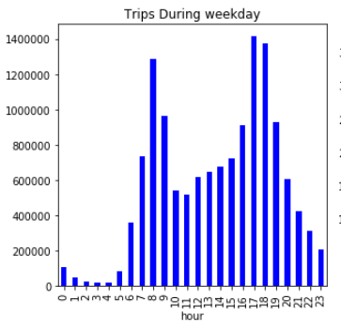
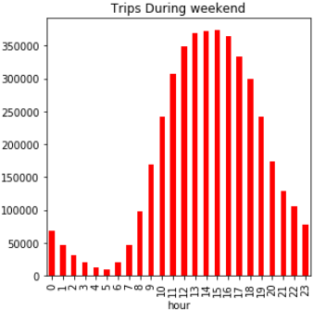
Exploratory Data Analysis
Station | Number of trips
Total Top 10 | 1,506,249
Total All Stations | 17,976,332
Highlights
Majority (88%) of users are annual subscribers
Top 10 frequented stations by subscribers explains 10% of total trips taken
Men make up majority of users
Highlights
Number of pick ups peaks during start and end day of work (~9-5) during weekday
Weekend are busiest during noon and afternoon
There is clear evidence of negative correlation between temperature and trips

Slide 5
Feature Creation & Data Segmentation
The objective is to improve revenue and/or lower investment. These observations were used to create features:
  Strengthening High traffic stations
  Less investment/ closure in less visited stations
  Commuters have repeat behavior during weekend
  Customers have preference towards downtown stations during weekends
Calculations:
  Normalized trips at every station (to a daily rate) by dividing by days in operation
  Ranked data into 3 percentiles
  Segmented each metric into high/medium and low:
Features:
Stations divided into Low , Medium and High Traffic stations
Stations divided into subscriber Low , Medium and High demand stations
Stations divided into customer Low , Medium and High demand stations
Assumptions based on segementation:
Based on findings, location and proximity to downtown play a big role in stations’ popularity and hence generating revenue
Trip frequency also varies between week day and weekends. Some stations are mostly used by subscribers during weekday for commuting. Whereas, some stations are more used by 1-time customers during weekends.
User Type
 | Subscriber High Demand | Subscriber Medium Demand | Subscriber Low Demand | Customer High Demand | Customer Medium Demand | Customer Low Demand
Weekend High |  | Station 281
Weekend Medium |  | Station72
Weekend Low |  |  | Station 233
Weekday High |  |  |  | Station72
Weekday Medium |  |  |  |  | Station 233
Weekday Low |  |  |  |  |  | Station 245
Some Examples:
Weekend / Weekday

